Slide 1


<BADER ABDULLATIF M ALMUTLAQ>
<05/07/2024>

Slide 2

Outline
Executive Summary
Introduction
Methodology
Results
Conclusion
Appendix

Slide 3
Executive Summary
This project is part of the IBM Data Science Capstone. The project aims to analyze Space X Falcon 9 first-stage landing data to understand the important features that make the landing successful and use it to develop a classification model to predict future landings.
Methodology: Data were collected from the Space X API and web scraping.
The data then were cleaned and preprocessed to be ready for analysis using Pandas and NumPy.
Exploratory data analysis was conducted to show relations in the data with SQL and Matplotlib.
Lastly, a classification model was developed to predict future landings
Findings: After analysis, we found that the most related factors to the success of the landing are: 'FlightNumber', 'PayloadMass', 'Orbit', 'LaunchSite', 'Flights', 'GridFins', 'Reused', 'Legs', 'LandingPad', 'Block', 'ReusedCount', 'Serial’

Slide 4
Introduction
Project background and context:
SpaceX, a leader in aerospace manufacturing and space transport, has made significant advancements with its Falcon 9 rocket. The first stage of Falcon 9 is designed to be reusable, landing back on Earth after launching payloads into orbit.
The reusability of rockets is a key milestone in reducing the cost of space travel and making it more sustainable. Successful landings of the Falcon 9 first stage are crucial for SpaceX's mission to revolutionize space travel.
This project is part of the IBM Data Science Capstone course on Coursera, aimed at leveraging data science techniques to analyze the landing outcomes of the SpaceX Falcon 9 first stage.
Project Questions:
What are the key factors that influence the success of the Falcon 9 first-stage landings?
How can we predict the success of future Falcon 9 first-stage landings using historical data?
What insights can be gained from the data to improve the reliability of future landings?

Slide 5

Section 1

Slide 6
Methodology
Executive Summary
Data collection methodology:
Describe how data was collected
Perform data wrangling
Describe how data was processed
Perform exploratory data analysis (EDA) using visualization and SQL
Perform interactive visual analytics using Folium and Plotly Dash
Perform predictive analysis using classification models
How to build, tune, evaluate classification models

Slide 7
Data Collection
Data were collected from the Space X API and web scraping.
Identify Data Sources:
SpaceX API
Web scraping from Wikipedia
Access and Retrieve Data:
Use API requests to gather data from SpaceX API
Implement web scraping techniques using BeautifulSoup.
Data Storage and Management:
Store raw data in CSV files
Use Pandas for initial data inspection and storage in data frames

Slide 8
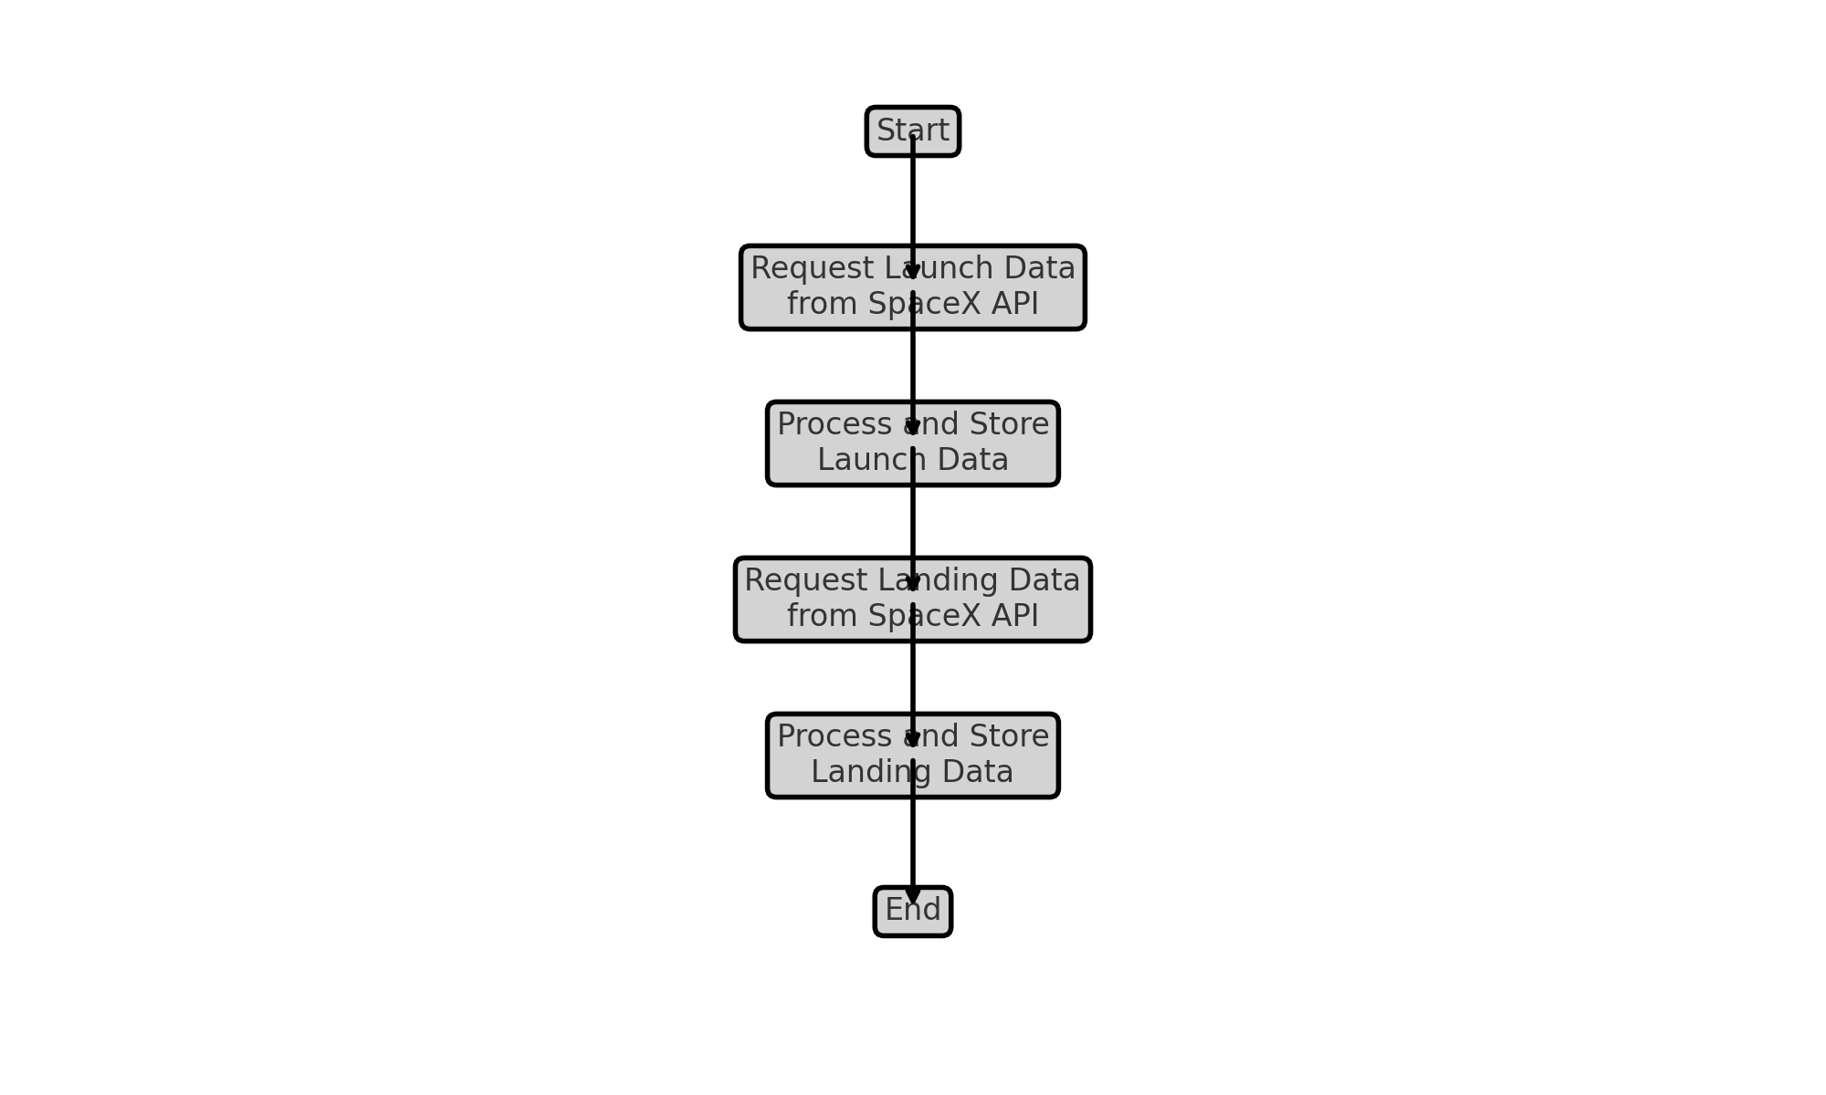
Data Collection – SpaceX API
Flow chart showing the steps of data collection.
GitHub URL of the completed SpaceX API calls notebook (https://github.com/Bader-Almutlaq/Rocket_Landing_Analysis/blob/main/1_Data_Collection.ipynb),

Slide 9
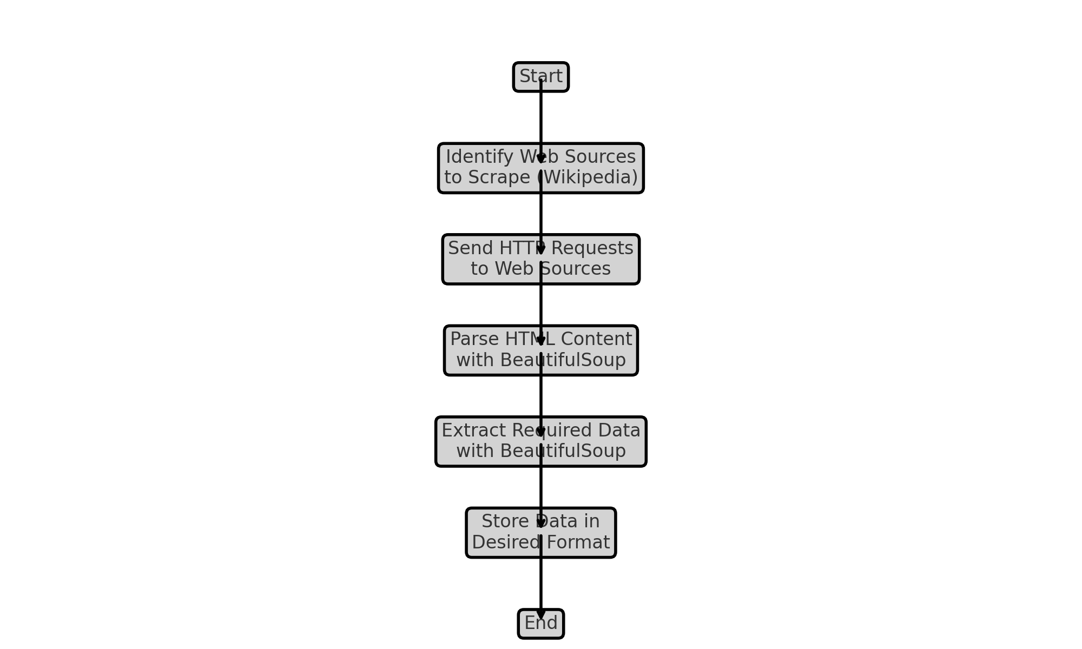
Data Collection - Scraping
Here is a flow chart for web scraping from Wikipedia
Add the GitHub URL of the completed web scraping notebook (https://github.com/Bader-Almutlaq/Rocket_Landing_Analysis/blob/main/2_Webscraping.ipynb)

Slide 10
Data Wrangling
Data were processed using Pandas and NumPy libraries
First, missing data were identified.
The missing data were replaced with the mean of the data
Unnecessary columns were dropped from the data frame
In addition, some statistical information were gathered using Pandas methods
Add the GitHub URL of the completed data wrangling related notebooks (https://github.com/Bader-Almutlaq/Rocket_Landing_Analysis/blob/main/3_Data_Wrangling.ipynb)

Slide 11
EDA with Data Visualization
To explore the data and visualize it multiple charts were used
Scatter plot to show the strength and correlation between the outcome of the landing and a specific feature
A line chart to show the landing success over the years
Add the GitHub URL of the completed EDA with the data visualization notebook, (https://github.com/Bader-Almutlaq/Rocket_Landing_Analysis/blob/main/3_Data_Wrangling.ipynb)

Slide 12
EDA with SQL
SQL queries that have been used to explore the data:
SELECT DISTINCT "Launch_Site" FROM SPACEXTABLE
SELECT * FROM SPACEXTABLE WHERE "Launch_Site" LIKE "CCA%" LIMIT 5
SELECT SUM("PAYLOAD_MASS__KG_") AS "Total Payload Mass" FROM SPACEXTABLE WHERE "Customer" == "NASA (CRS)”
SELECT AVG("PAYLOAD_MASS__KG_") AS "Average Payload Mass" FROM SPACEXTABLE WHERE "Booster_Version" LIKE "F9 v1.1%”
SELECT MIN("Date") FROM SPACEXTABLE WHERE "Landing_Outcome" == 'Success (ground pad)’
SELECT `Booster_Version` FROM SPACEXTABLE WHERE `Landing_Outcome` == "Success (drone ship)" AND `PAYLOAD_MASS__KG_` > 4000 AND `PAYLOAD_MASS__KG_` < 6000
SELECT `Mission_Outcome`, COUNT(*) AS COUNT FROM SPACEXTABLE GROUP BY `Mission_Outcome`
SELECT `Booster_Version` FROM SPACEXTABLE WHERE `PAYLOAD_MASS__KG_` == (SELECT MAX(`PAYLOAD_MASS__KG_`) FROM SPACEXTABLE)
SELECT SUBSTR(`Date`, 6,2) As month, `Landing_Outcome`, `Booster_Version`, `Launch_Site` FROM SPACEXTABLE WHERE SUBSTR(`Date`,0,5) == '2015' AND `Landing_Outcome` == 'Failure (drone ship)’
SELECT `Landing_Outcome`,COUNT(*) AS `count` FROM SPACEXTABLE GROUP BY `Landing_Outcome` ORDER BY `count` DESC
Add the GitHub URL of the completed EDA with SQL notebook, (https://github.com/Bader-Almutlaq/Rocket_Landing_Analysis/blob/main/4_EDA_SQL.ipynb)

Slide 13
Build an Interactive Map with Folium
Using Folium we created an interactive map to further visualize the data
The launch site has been marked on the map using markers and clusters to gather them and adding pop-ups to the sites.
A circle was created around every launch site
A label that indicated if the launch was successful or not.
Distance to the closest coast, city, road, train track were calculated and marked on the map
A line was created to show the distance.
GitHub URL of the completed interactive map with Folium map, (https://github.com/Bader-Almutlaq/Rocket_Landing_Analysis/blob/main/6_Interactive_Map_Folium.ipynb)

Slide 14
Build a Dashboard with Plotly Dash
Pie chart was created in the dashboard to show the rate of sucsess in all the site or in a specific site.
Scatter plot was created to show the correlation between the payload mass and the success in all the sites or in a specific site
These plots help us understand if the launch site and the payload affect the success of the launch and we can identify which site has the most successful landings.
GitHub URL of the completed Plotly Dash lab, (https://github.com/Bader-Almutlaq/Rocket_Landing_Analysis/blob/main/7_Plotly_Dash_Dashboard.ipynb)

Slide 15
Predictive Analysis (Classification)
After understanding and cleaning the data we developed classification models.
The models were created using Sklearn and we used SVM, Classification Trees and Logistic Regression.
Grid search was used to find the best hyper parameters for each model.
The data was split to testing and training data.
The models were evaluated by their accuracy.
A heat map was created for the confusion matrix.
GitHub URL of the completed predictive analysis lab, (https://github.com/Bader-Almutlaq/Rocket_Landing_Analysis/blob/main/8_Spacex_ML_Predections.ipynb)

Slide 16
Results
After analysis, we found that the most related factors to the success of the landing are: 'FlightNumber', 'PayloadMass', 'Orbit', 'LaunchSite', 'Flights', 'GridFins', 'Reused', 'Legs', 'LandingPad', 'Block', 'ReusedCount', 'Serial’
This was found by the use of scatter graphs to find the correlation between them and the success of the landing
View section 2 for the charts that were used.
The model was developed using these features and LR preformed the best in predicting landing outcomes.

Slide 17

Section 2

Slide 18
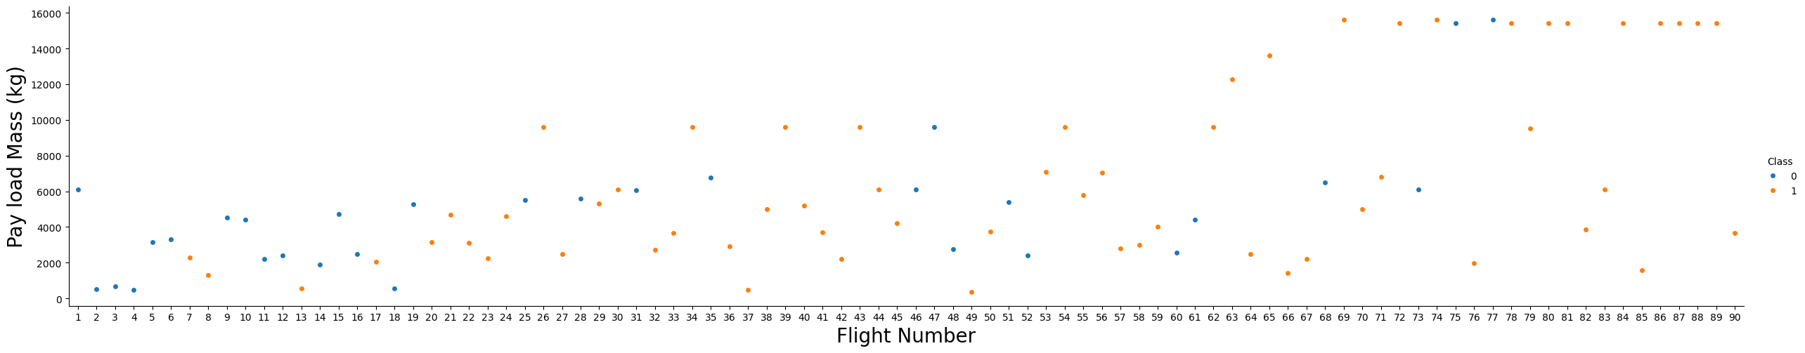
Flight Number vs. Launch Site
We see that different launch sites have different success rates. Also, we can see that higher flight numbers have higher success rate and.

Slide 19
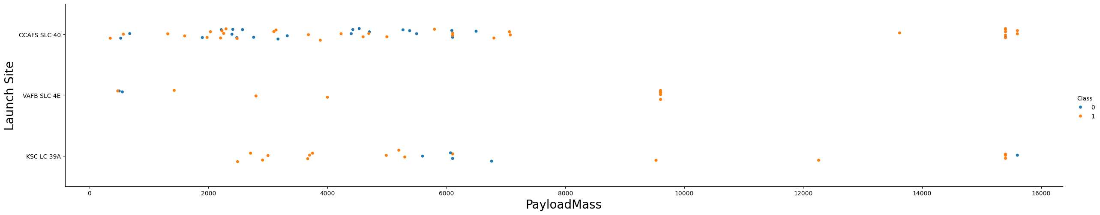
Payload vs. Launch Site
We can see that VAFB-SLC launch site there are no rockets launched for heavy payload mass(greater than 10000).
Heavy payloads have higher succsess rate.

Slide 20
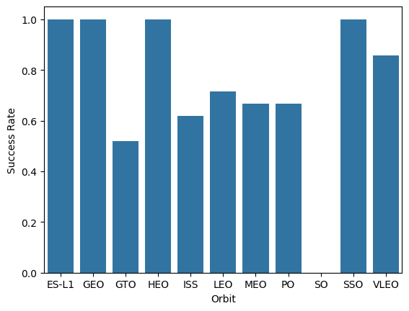
Success Rate vs. Orbit Type
We can see that SO orbit have 0 success rate.

Slide 21
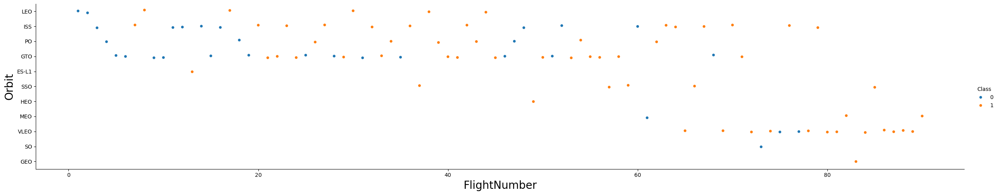
Flight Number vs. Orbit Type
We can see that in the LEO orbit the Success appears related to the number of flights; on the other hand, there seems to be no relationship between flight number when in GTO orbit

Slide 22
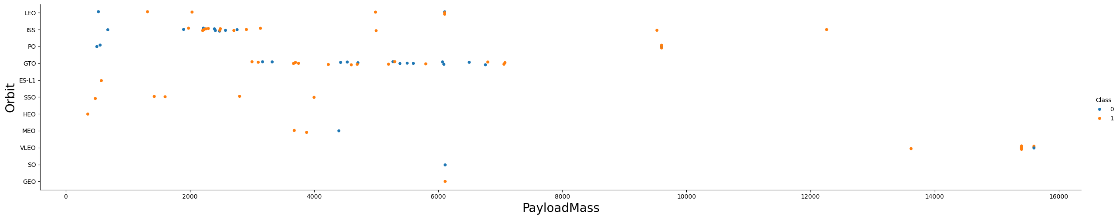
Pay Load Mass vs. Orbit Type
With heavy payloads the successful landing or positive landing rate are more for Polar,LEO and ISS.
However for GTO we cannot distinguish this well as both positive landing rate and negative landing(unsuccessful mission) are both there here.

Slide 23
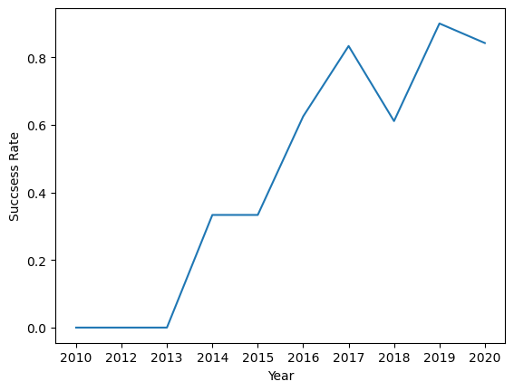
Launch Success Yearly Trend
you can observe that the sucess rate since 2013 kept increasing till 2020

Slide 24
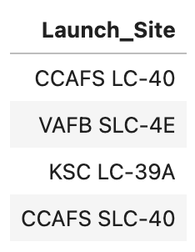
All Launch Site Names
SELECT DISTINCT "Launch_Site" FROM SPACEXTABLE
This query retrieves all unique values from the column "Launch_Site" in the table SPACEXTABLE, ensuring each site is listed only once.
Result:

Slide 25
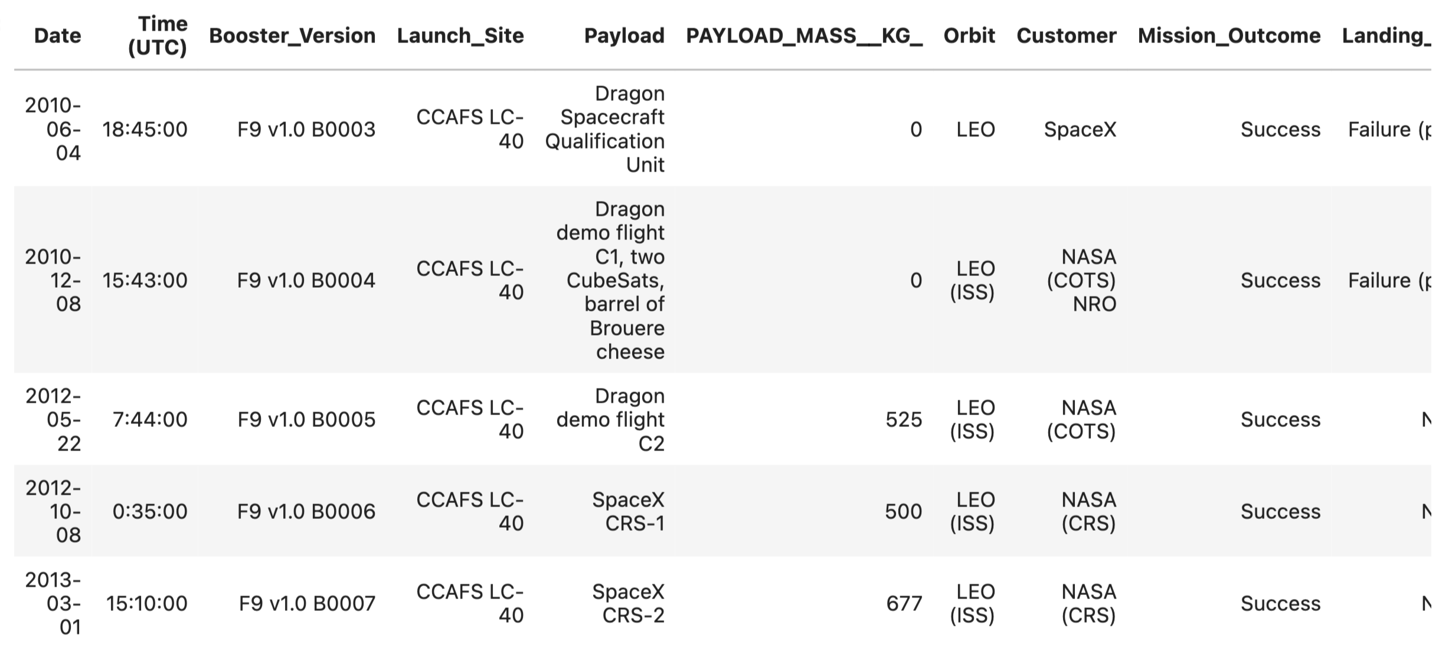
Launch Site Names Begin with 'CCA'
SELECT * FROM SPACEXTABLE WHERE "Launch_Site" LIKE "CCA%" LIMIT 5
This query selects all columns (*) from the table SPACEXTABLE where the "Launch_Site" starts with "CCA", limiting the result to 5 rows.
Result:

Slide 26
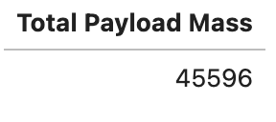
Total Payload Mass
SELECT SUM("PAYLOAD_MASS__KG_") AS "Total Payload Mass" FROM SPACEXTABLE WHERE "Customer" == "NASA (CRS)"
This calculates the sum of the "PAYLOAD_MASS__KG_" column for rows where the "Customer" is specifically "NASA (CRS)", aliasing the result as "Total Payload Mass".
Result:

Slide 27
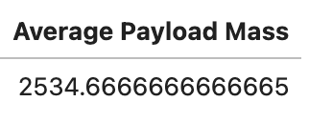
Average Payload Mass by F9 v1.1
SELECT AVG("PAYLOAD_MASS__KG_") AS "Average Payload Mass" FROM SPACEXTABLE WHERE "Booster_Version" LIKE "F9 v1.1%"
This computes the average (AVG) of the "PAYLOAD_MASS__KG_" column for rows where the "Booster_Version" starts with "F9 v1.1%", naming the result as "Average Payload Mass".
Result:

Slide 28
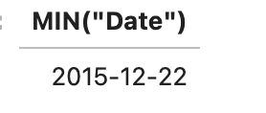
First Successful Ground Landing Date
SELECT MIN("Date") FROM SPACEXTABLE WHERE "Landing_Outcome" == 'Success (ground pad)'
This retrieves the earliest (MIN) date from the "Date" column in SPACEXTABLE where the "Landing_Outcome" is specifically 'Success (ground pad)’.
Result:

Slide 29
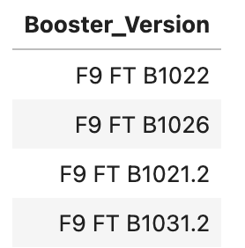
Successful Drone Ship Landing with Payload between 4000 and 6000
SELECT Booster_Version FROM SPACEXTABLE WHERE Landing_Outcome == "Success (drone ship)" AND PAYLOAD_MASS__KG_ > 4000 AND PAYLOAD_MASS__KG_ < 6000
This query selects the "Booster_Version" from rows in SPACEXTABLE where the "Landing_Outcome" is 'Success (drone ship)' and the "PAYLOAD_MASS__KG_" is between 4000 and 6000 kg.
Result:

Slide 30
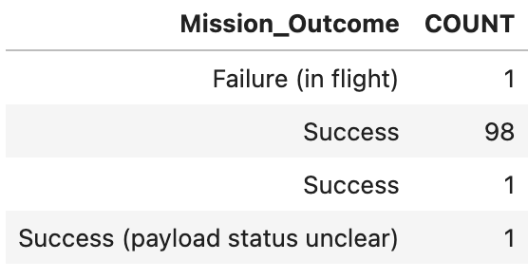
Total Number of Successful and Failure Mission Outcomes
SELECT Mission_Outcome, COUNT(*) AS COUNT FROM SPACEXTABLE GROUP BY Mission_Outcome
This groups rows in SPACEXTABLE by the "Mission_Outcome" column and counts the occurrences of each outcome, displaying the result alongside each outcome.
Result:

Slide 31
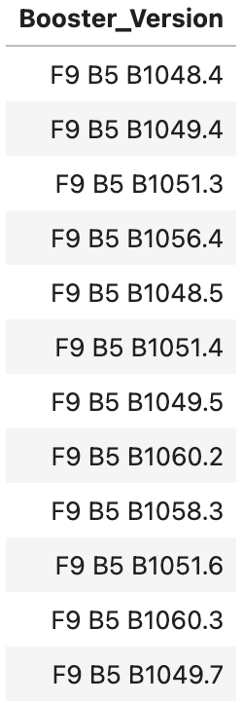
Boosters Carried Maximum Payload
SELECT Booster_Version FROM SPACEXTABLE WHERE PAYLOAD_MASS__KG_ == (SELECT MAX(PAYLOAD_MASS__KG_) FROM SPACEXTABLE)
This retrieves the "Booster_Version" from SPACEXTABLE for rows where the "PAYLOAD_MASS__KG_" is equal to the maximum payload mass found in the entire SPACEXTABLE.
Result:

Slide 32
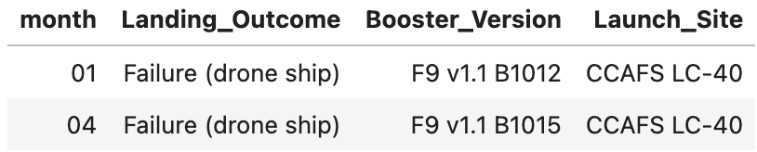
2015 Launch Records
SELECT SUBSTR(Date, 6,2) As month, Landing_Outcome, Booster_Version, Launch_Site FROM SPACEXTABLE WHERE SUBSTR(Date,0,5) == '2015' AND Landing_Outcome == 'Failure (drone ship)'
This selects the month (extracted from the "Date" column), "Landing_Outcome", "Booster_Version", and "Launch_Site" columns from SPACEXTABLE for rows where the year part of "Date" is '2015' and the "Landing_Outcome" is specifically 'Failure (drone ship)’.
Result:

Slide 33
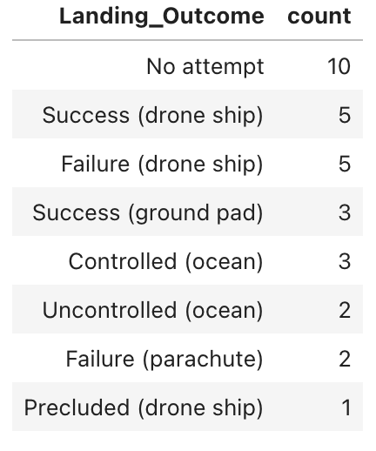
Rank Landing Outcomes Between 2010-06-04 and 2017-03-20
SELECT Landing_Outcome,COUNT(*) AS count FROM SPACEXTABLE WHERE `Date` BETWEEN '2010-06-04' AND '2017-03-20' GROUP BY Landing_Outcome ORDER BY count DESC
This groups rows in SPACEXTABLE by the "Landing_Outcome" column, counts the occurrences of each outcome, and orders the results in descending order based on the count where the date of these outcomes between '2010-06-04' AND '2017-03-20’ .
Result:

Slide 34

Section 3

Slide 35
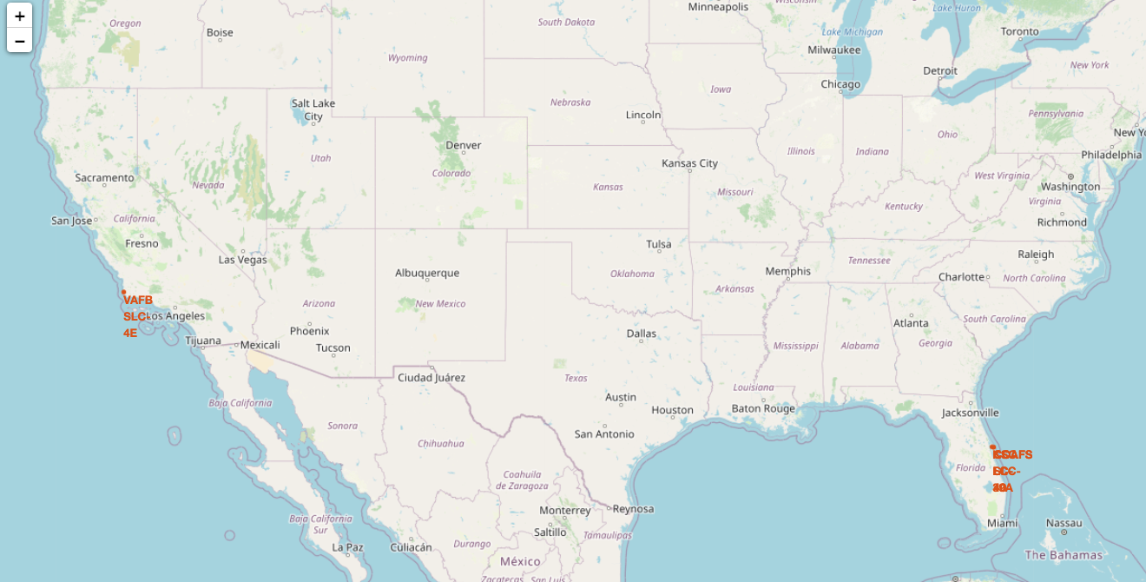
Launch Sites Map
None of these launch sites are very close to the Equator (which is at 0° latitude)
all of these launch sites are indeed in very close proximity to the coast, either the Atlantic or Pacific Ocean.

Slide 36
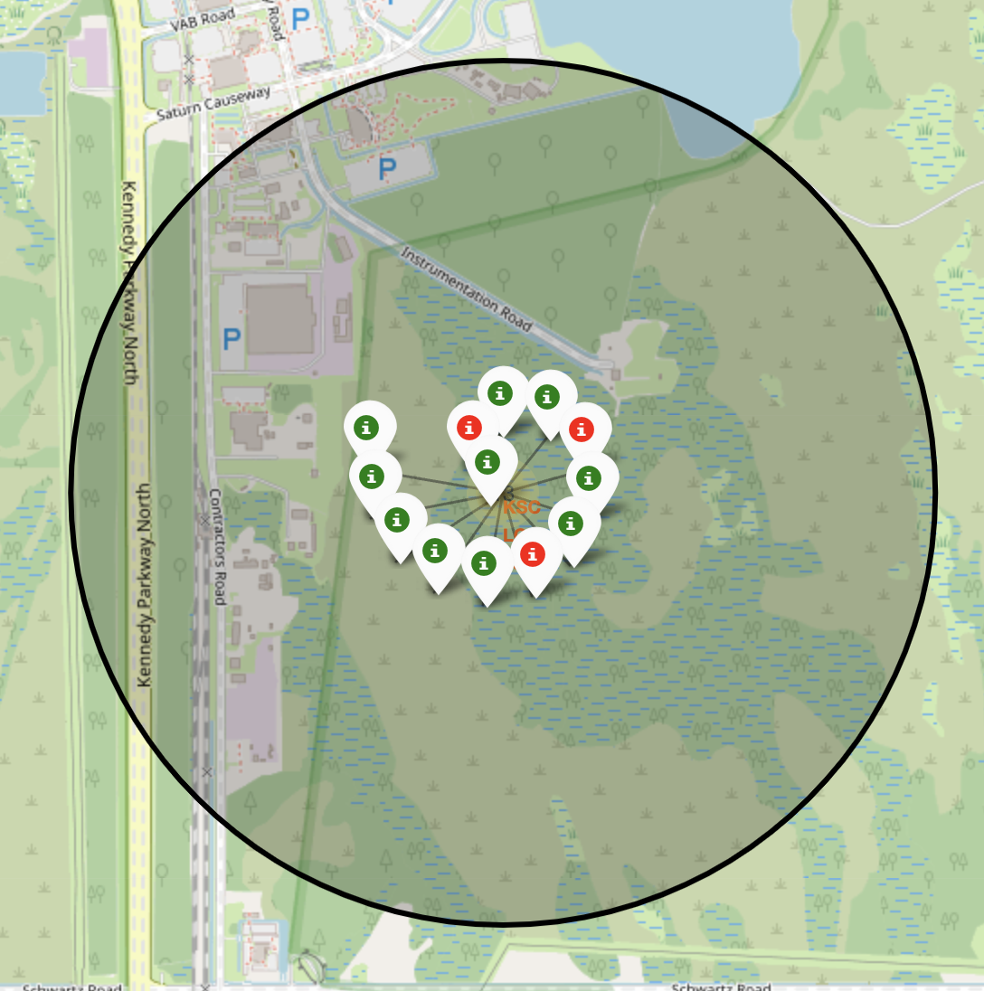
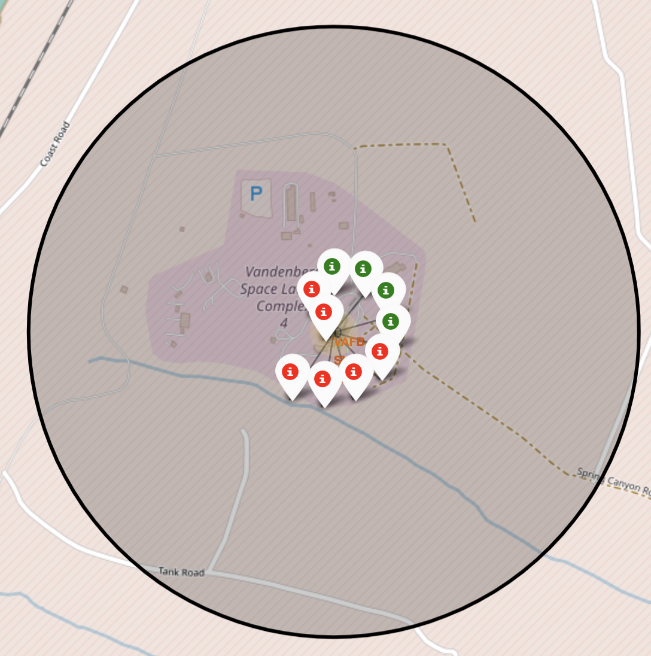
Launch Labels
From the color-labeled markers in marker clusters, you should be able to easily identify which launch sites have relatively high success rates.

Slide 37
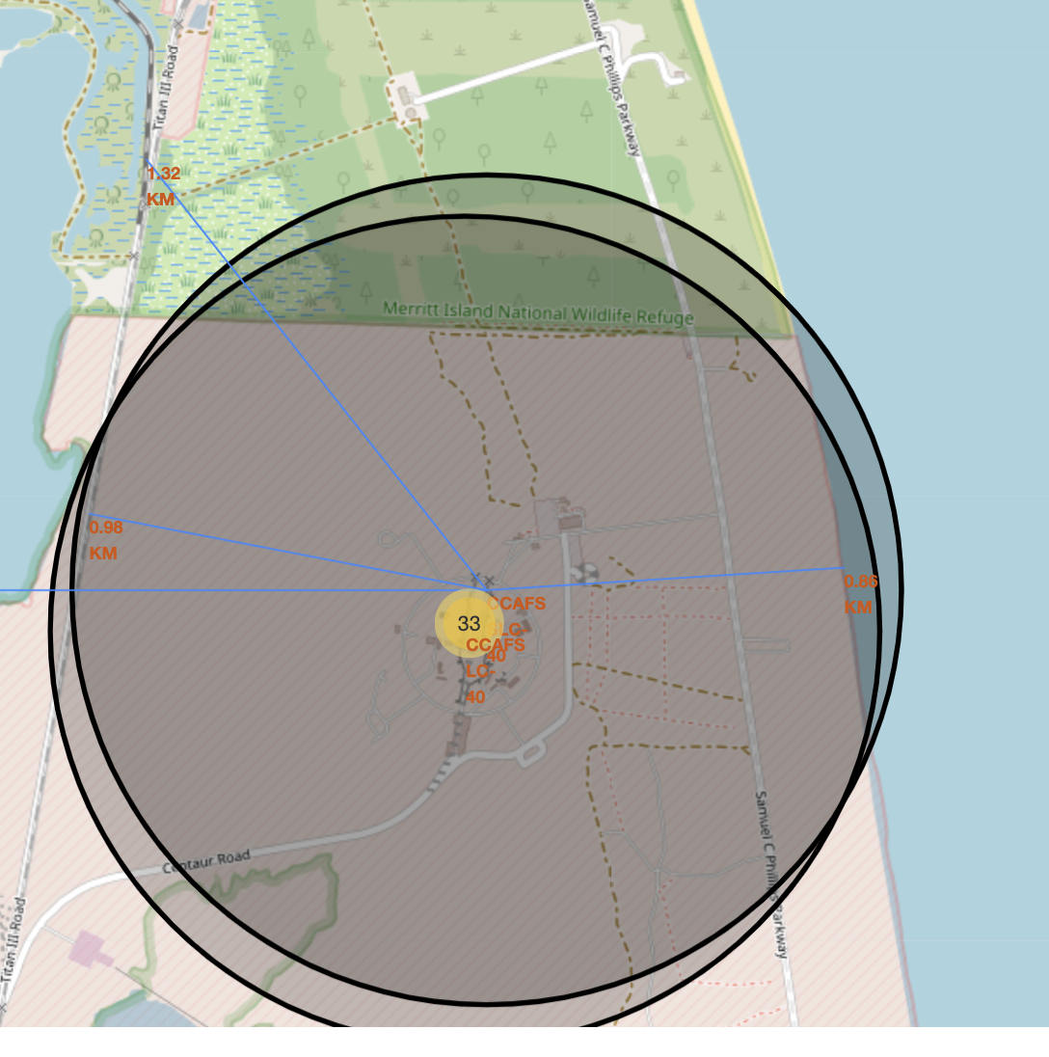
Launch Site Proximities

Slide 38

Section 4

Slide 39
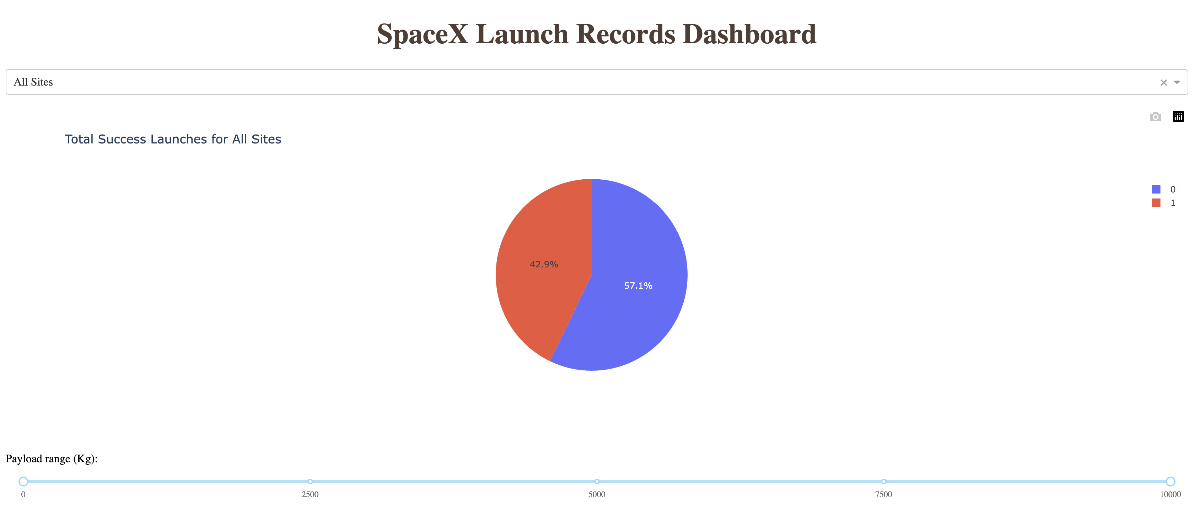
Launch Succusses Rate

Slide 40
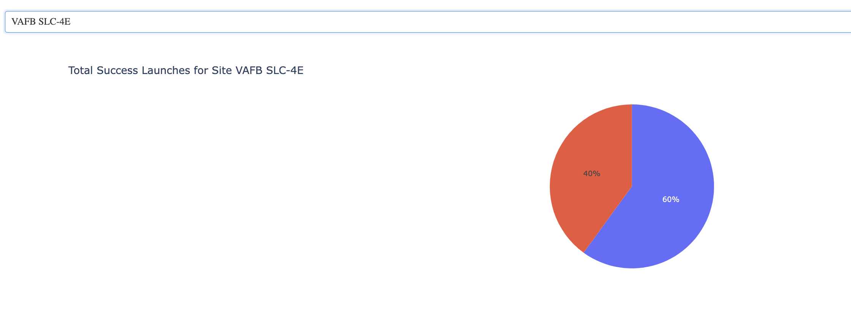
Most Successful Site

Slide 41
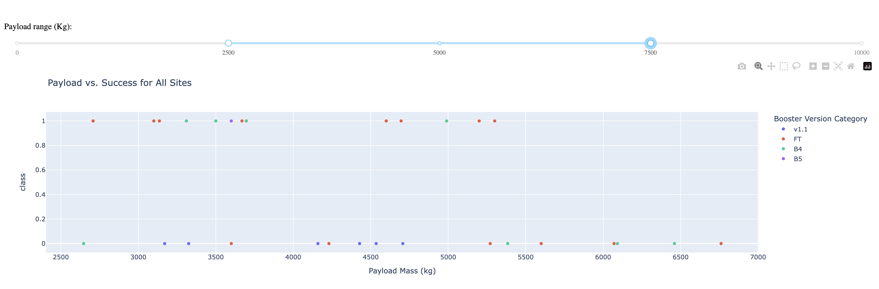
Pay Load vs Success

Slide 42

Section 5

Slide 43
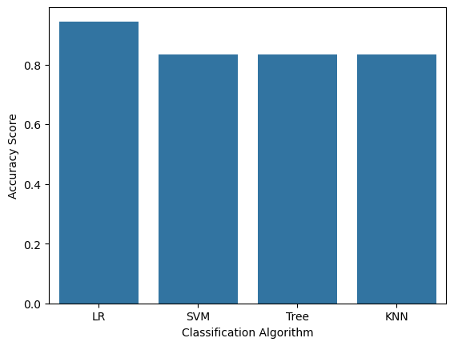
Classification Accuracy
We can see that LR has the highest accuracy while the other models are equal.

Slide 44

Confusion Matrix
Examining the confusion matrix, we see that logistic regression can distinguish between the different classes. We see that the major problem is false positives.

Slide 45
Conclusions
Launch success depend on many features
Features that affect the success the most are 'FlightNumber', 'PayloadMass', 'Orbit', 'LaunchSite', 'Flights', 'GridFins', 'Reused', 'Legs', 'LandingPad', 'Block', 'ReusedCount', 'Serial
Launch sites are usually close to the coast and far from the cities.
The best model for classification for this problem is LR

Slide 46
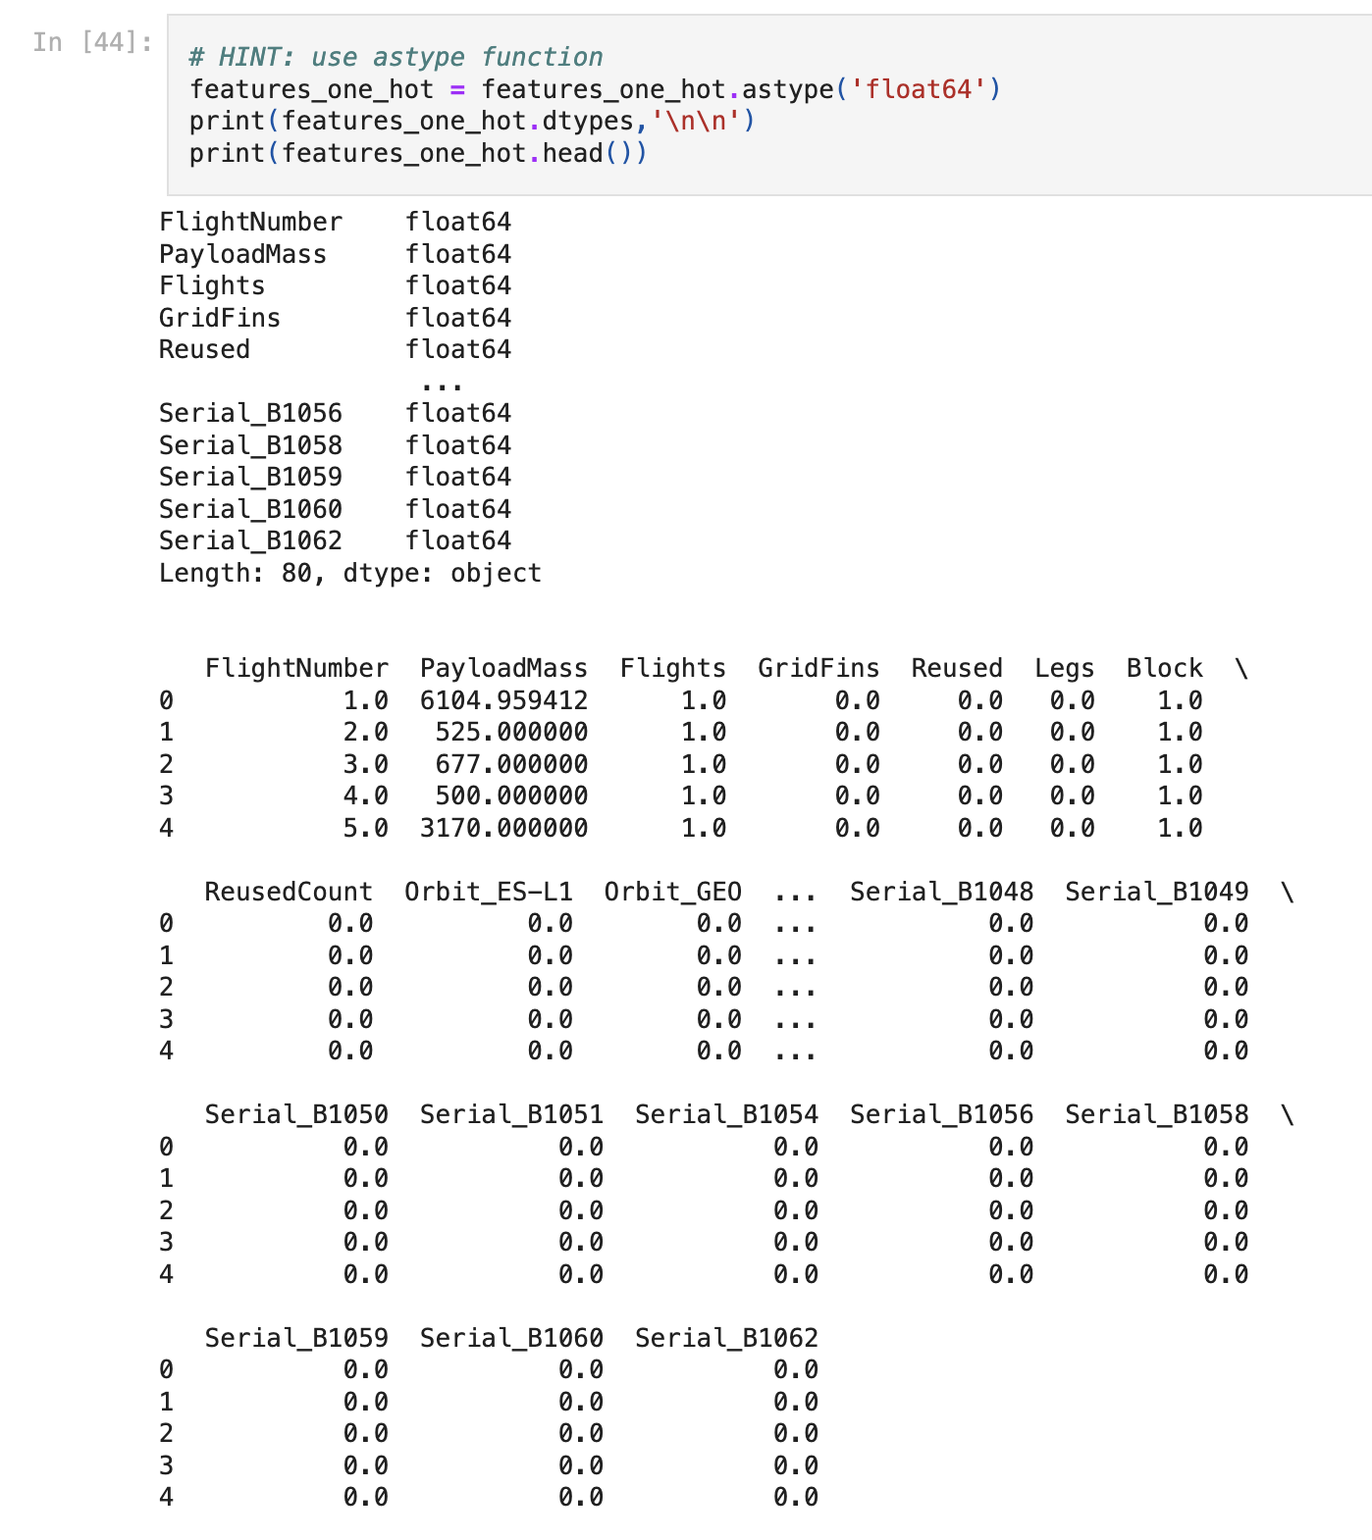
Appendix

Slide 47


